Slide 1
Introduction To R
EPA’s Emerging Leaders Network 2021-02-24 Jeff Hollister, ORD/CEMM/ACESD

Slide 2

Who am I?
Landscape ecology, GIS, Lakes, and Data Science
US EPA Research Ecologist since ~2006
Worked on: Forests, wetlands, gopher tortoise, estuaries, lakes, cyanobacteria, …
useR since 2000 (yikes!)
@jhollist, #rstats

Slide 3

What is R?
“Free software environment for statistical computing and graphics”
Ross Ihaka and Robert Gentleman
Dialect of the S language
R’s first release: 1993
Version 1.0: 2000
Current version 4.0.4, Feb 2021.
aka “Lost Library Book”
Excels at statistics and visualization
Fully functional, general purpose programming language
Why is it called “R”?

Slide 4

Why use R?
Free!
Statistics and Graphics
GIS/Spatial
Writing Papers
Presentations (like this one)
Programming
Develop new tools
Reproducibility
Open Science

Slide 5

R vs. Python

Slide 6

R vs. & Python
- RStudio Panel discussion from yesterday: https://www.youtube.com/watch?v=6mp-BWPnqK4

Slide 7

R at EPA
Large and active community
July 2020: 1142 installs
HQ offices only
R Users Group
Started ~2013/2014
Channel in Data Science team
Sharepoint (legacy)
Monthly meetings
Bi-annual face to face
Installation (for HQ Offices, regions are Ad hoc)
R
RStudio
Rtools (required build tools for Windows)

Slide 8
One Minute Demos

Slide 9
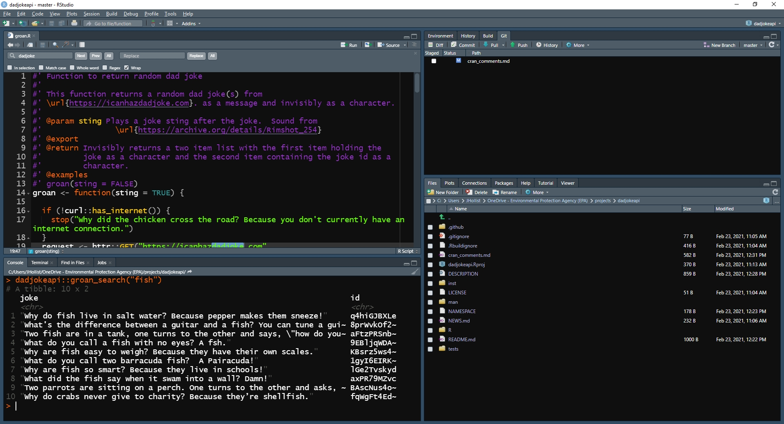
RStudio
Integrated Development Environment
Also a company that supports the R community
RStudio 1-minute Demo

Slide 10

Base R
Fresh out of the box you get 6618 functions!
You can do a lot
stats, graphics, parallel computing, …
Base R 1-minute Demo

Slide 11

Extending Base R: Packages
Community developed extensions
Many quality checks
Two main sources
CRAN (https://cran.r-project.org/): 17147 packages
Bioconductor (https://www.bioconductor.org/): 20463 packages
Genomics/bioinformatics

Slide 12

What can you do with R?
Well-known:
Statistics
Graphics
Less well-known:
Geospatial/GIS
Documents
word, pdf, ppt
Web applications
Offbeat things

Slide 13
Offbeat 1 minute demo
beepr: Easily Play Notification Sounds on any Platform
BRRR: Rap adlibs in R
dadjokeapi: Return a Dad Joke
demotivr: Show Demotivational Messages on Errors
kittyR: Kitty pictures and meows from R console
praise: Praise Users
memer: A tidyverse compatible package for creating memes in R using magick
rainbowwrite: Rainbow Coloured Output
wesanderson: A Wes Anderson Palette Generator
# Noises! beepr::beep(2) kittyR::meowR(4) BRRR::skrrrahh(16) # Messages dadjokeapi::groan() praise::praise() # Images and colors library(magrittr) meme_get("DosEquisMan") %>% meme_text_top("I don't always useR!", size = 28) %>% meme_text_bottom("But when I do, I procrastinate\nby making memes.", size = 28) joke <- dadjokeapi::groan(FALSE)$joke rainbowrite::lolcat(joke)

Slide 14
Statistics 1 minute demo
# Read data from a URL
nla_url <- "https://www.epa.gov/sites/production/files/2014-10/nla2007_chemical_conditionestimates_20091123.csv"
nla_wq <- read.csv(nla_url)
# Remove missing data nla_wq <- nla_wq[complete.cases(nla_wq[,c("CHLA", "PTL", "NTL")]),]
# Some stats mean(nla_wq$CHLA) t.test(nla_wq$CHLA ~ nla_wq$LAKE_ORIGIN) nla_lm <- lm(log10(CHLA) ~ log10(PTL) + log10(NTL),
data = nla_wq) summary(nla_lm)

Slide 15
Visualization 1 minute demo
# Use ggplot2 to create viz
library(ggplot2)
# Iteratively add parts to my plot nla_wq %>% ggplot(aes(x=NTL,y=PTL)) + geom_point(aes(size=CHLA, color=CHLA)) + scale_x_log10() + scale_y_log10() + scale_color_continuous(low = "springgreen", high = "darkgreen") + geom_smooth(method = "lm", color = "grey50") + theme_classic() + labs(title = "Total Nitrogen, Total Phosphorus, and Chlorophyll Associations", x = "Log 10 (Total Nitrogen)", y = "Log 10 (Total Phosphorus)")

Slide 16
Geospatial 1 minute demo
# Load up several spatial packages
library(USAboundaries) library(sf) library(dplyr) library(elevatr) library(mapview) library(raster) # Get map of lower 48 states usa_l48 <- us_boundaries() %>% filter(state_abbr != "HI" & state_abbr != "AK" & state_abbr != "PR")
# Get DEM. Zoom level 4 returns DEM of ~ 3.8km resolution usa_l48_dem <- get_elev_raster(usa_l48, src="aws", z = 4, clip = "location")
# Create quick leaflet map mapview(usa_l48_dem) + usa_l48

Slide 17

Documents 1 minute demo
R mixed with Markdown:
https://daringfireball.net/projects/markdown
PDF
Word Documents
Presentations
Illustration credit: Allison Horst, https://github.com/allisonhorst/stats-illustrations

Slide 18

Web 1 minute demo
Shiny
Shiny examples:
https://shiny.rstudio.com/gallery/
Shiny at EPA
https://shiny.epa.gov/fcedts/
Internal at NCC
Working on other options
Web and HTML tools galore
Visualization
Web Scraping
APIs

Slide 19
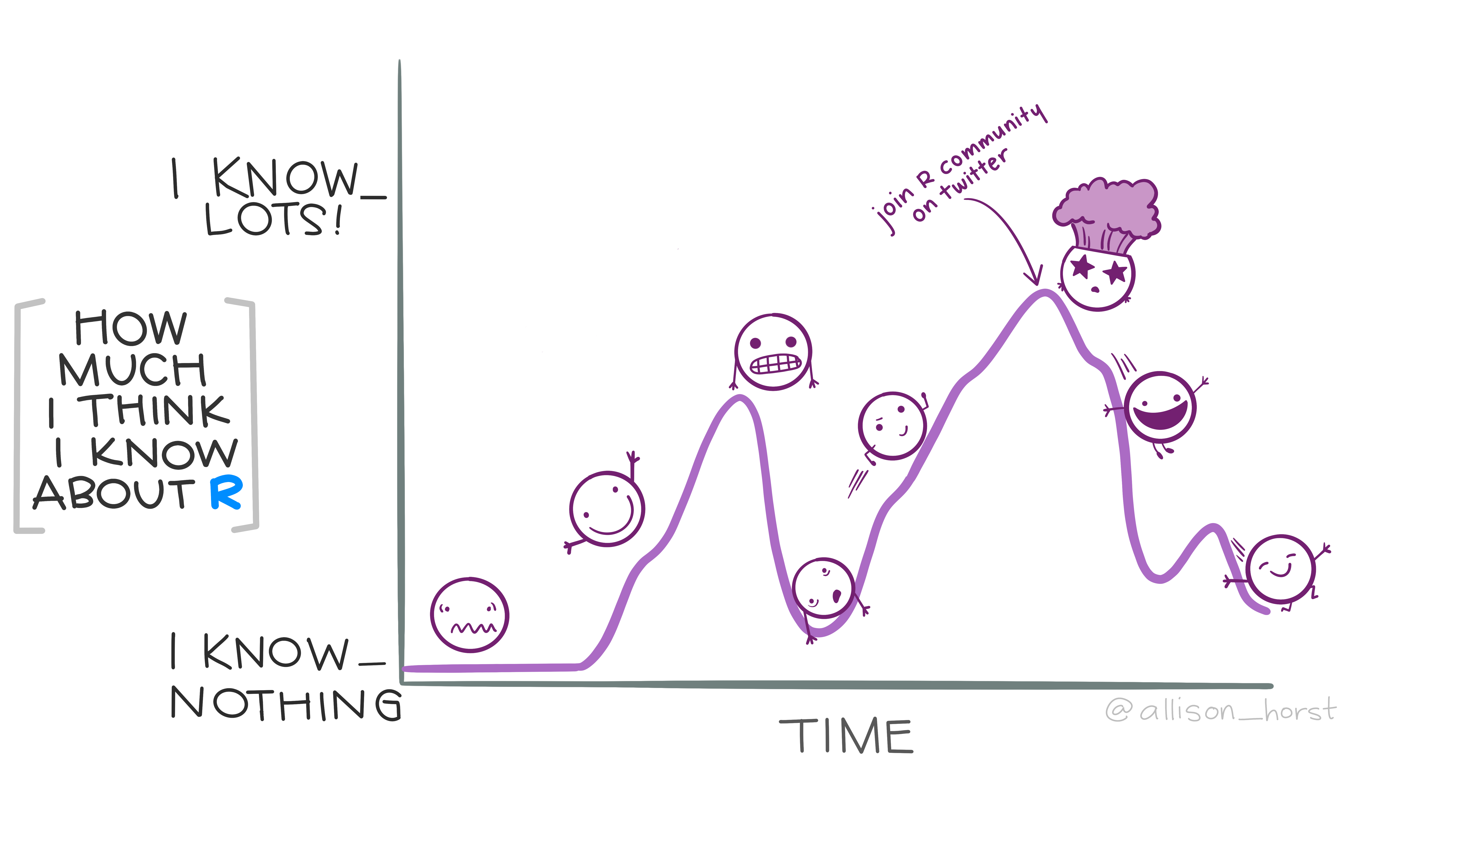
Learn More
Twitter
#rstats, #TidyTuesday, #rspatial
EPA R User Group
Monthly meetings, face to face meetings, webinars
learnr:
https://rstudio.github.io/learnr/
The Carpentries:
https://carpentries.org/
Illustration credit: Allison Horst, https://github.com/allisonhorst/stats-illustrations

Slide 20
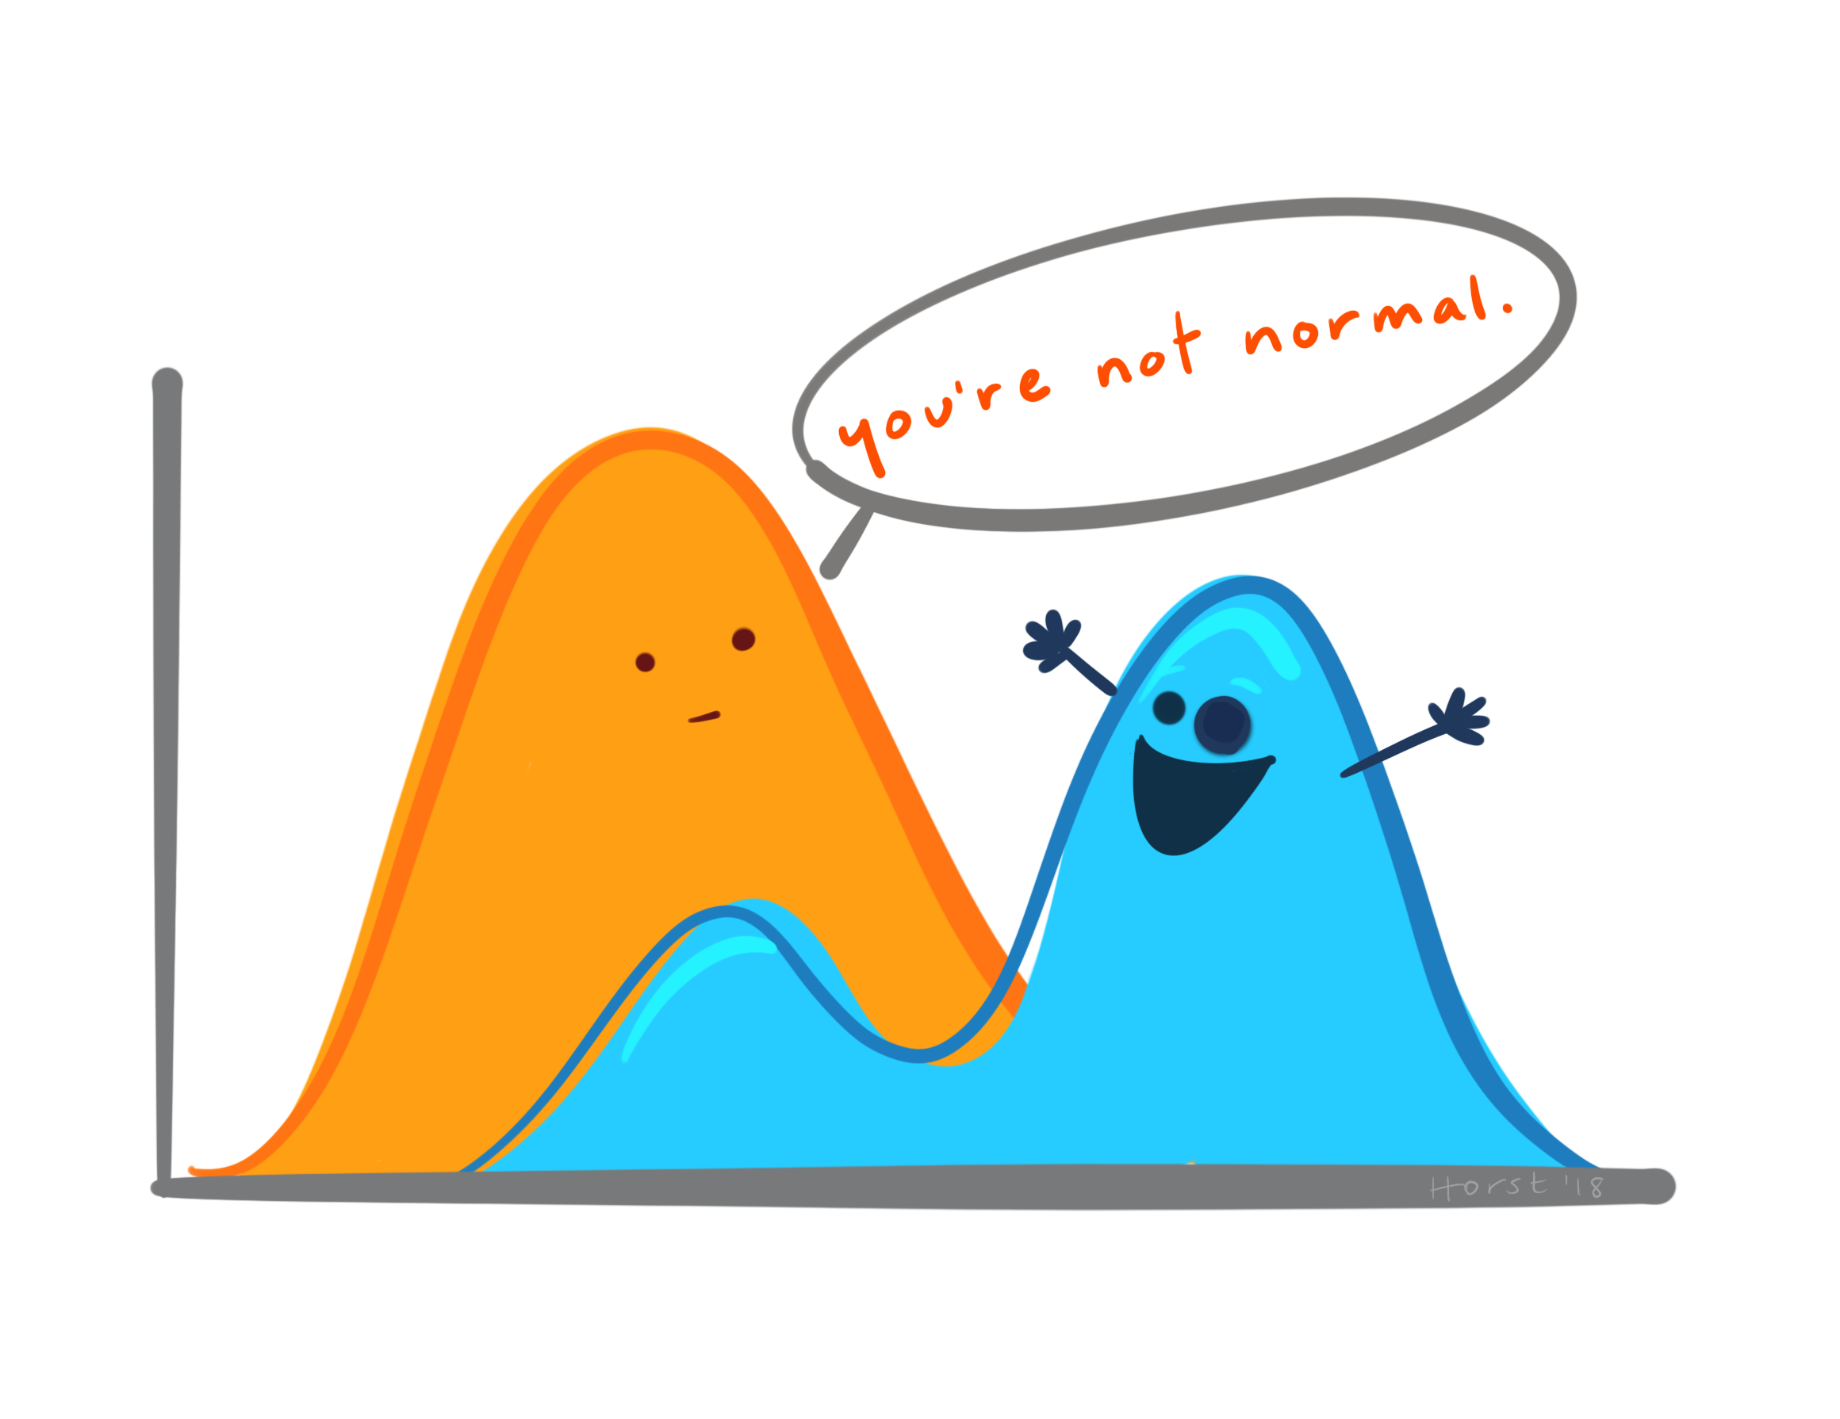
Questions
Illustration credit: Allison Horst, https://github.com/allisonhorst/stats-illustrations

